Slide 1

We’ll get started soon! While you wait, pull up the site and try a transcription!
Notes:
Pull up this slide while your participants are arriving. If you’re focusing on a specific person or campaign, you could add an image of them here.

Slide 2
Welcome to the Transcribe-a-thon!
Notes:
You can add the specific title of your event and name(s) of your presenters here

Slide 3
Today’s Agenda
Introduction to crowdsourcing and By the People
How to contribute
Let’s try it!
Notes:
Introduce the event and what you’ll be doing. This is a good time to find out how many people have visited or contributed to the site? More than 5? 20?

Slide 4
Crowdsourcing: A definition
A form of engagement with cultural heritage that contributes toward a shared, significant goal or research area, by asking the public to undertake tasks that cannot be done automatically, in an environment where the tasks, goals (or both) provide inherent rewards for participation.”
Dr. Mia Ridge, Digital Curator,
British Library Digital Scholarship team
“From Tagging to Theorizing: Deepening Engagement with Cultural Heritage through Crowdsourcing.” 2013, Curator: The Museum Journal, p. 437

Slide 5
What does it mean?
Inviting the public to contribute and connect
Collaborate toward a shared goal – increased access to and use of collections
Take part in discovery, learning, problem-solving, knowledge-sharing, data generation, & research
Volunteer when and where you can!

Slide 6
Crowdsourcing
Other crowdsourcing: Superbowl 2014 reactions https://carto.com/gallery/twitter-superbowl/
Notes:
If we could see crowdsourcing activity from space, it would look something like this. In the case of the Library of Congress, crowdsourcing enables people to become virtual volunteers. They enter into a two-way relationship with the Library in which they contribute their valuable time and knowledge to enhance Library collections, and in return learn new skills, such as how to read cursive or conduct online research, and experience a deeper relationship with Library staff and fellow volunteers.

Slide 7
By the People
Project launched in October 2018, inviting the public to transcribe and tag digitized Library of Congress collections (mostly handwritten text) to make them:
Keyword searchable
Readable by individuals and accessibility technologies
Available for textual analysis

Slide 8
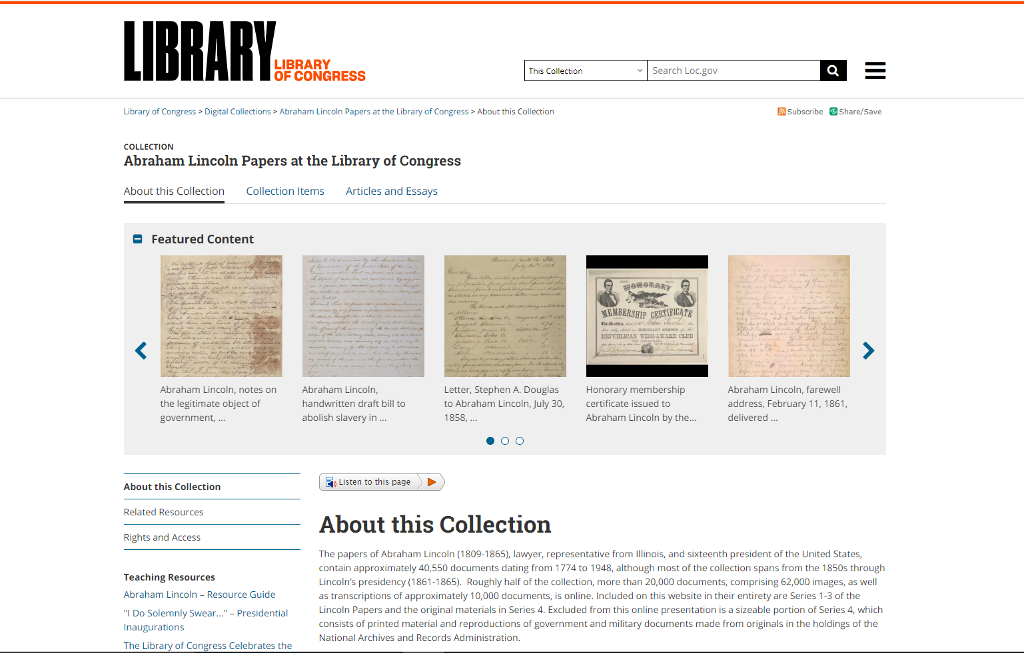
Notes:
You can see this already in action with completed transcription pages from the Abraham Lincoln Papers which have been returned to loc.gov. This is the home page for the Lincoln Papers. As part of this collection on the main Library of Congress digital collections website, transcriptions aid in discovery and access. Visitors to our website can now conduct word searches and surface previously ‘hidden’ treasures.

Slide 9
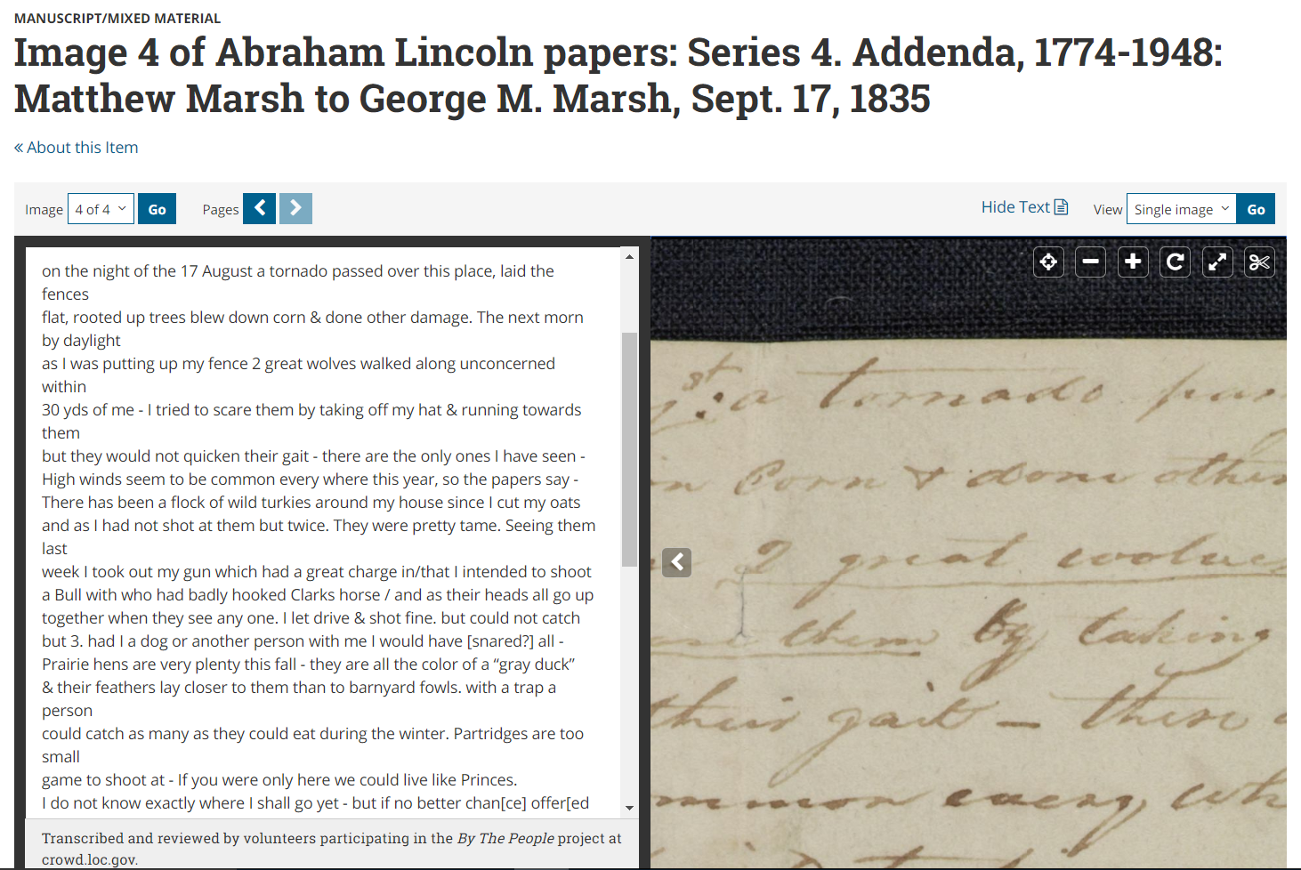
Notes:
Such as this gem, which I found by searching the word “tornado.” In this letter Matthew Marsh boasts to his brother back in New England of life on the Illinois frontier, including tumultuous weather and his relationship with post master Abraham Lincoln “a very clever fellow and particular friend of mine” who conveniently leaves his office door open when he’s not around! This view shows you how the transcriptions display alongside the digitized items. This screenshot is zoomed in to show the word “tornado”, which you can also see in the first line of typed text. Without the transcription, a search of that word would not have found this document.

Slide 10
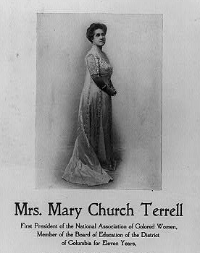
Mary Church Terrell Papers
Who was she? Educator, lecturer, suffragist, and civil rights activist
Papers include letters to and from Terrell, her diaries, speeches, writings, and more
~13,000 documents digitized and published at loc.gov in 2018
7,817 pages in By the People
[Stock poster announcing a lecture to be given by Mrs. Mary Church Terrell, "1st Pres. of Natl. Assoc. of Colored Women" with an illus. of Mrs. Terrell (full, standing, facing right)]
Notes:
This is a good time to talk about the topic of your transcribe-a-thon if there is one. Here is an example slide for Mary Church Terrell. You can transition to your topic from the concept of searchable/accessible text by talking about what information might be surfaced through its transcription.

Slide 11
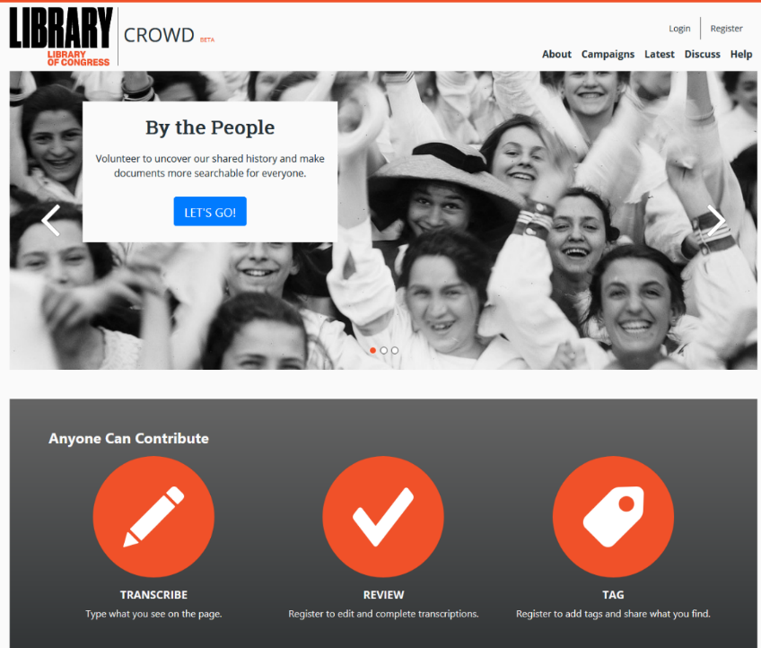
Crowd.loc.gov
Registered
users
Anonymous users
Notes:
So how does it work? The process is illustrated on the By the People homepage, which you can find at crowd.loc.gov.
By the People volunteers can transcribe, review and tag images of handwritten and printed materials in LOC collections. Transcriptions are created and reviewed by volunteers. Anyone can transcribe without creating an account. Only registered volunteers can review other people’s transcriptions or add tags. Completing a page requires at least 2 volunteers -- transcribe something and then another volunteer must review it. If it looks good, they mark it complete; if they find an error, they can correct it and submit it for another round of volunteer review. We want everyone to feel welcome to give it a try and do their best. The safety net of review allows you to give it a go, make mistakes, and learn from them!

Slide 12

Notes:
Do a demonstration of how to navigate and contribute to the site. The image above is hyperlinked. Important functionality to show
Finding something to work on:
Jump into activity from the hompage
Or choose something to work on by drilling down through Campaigns
What are the current campaigns available?
Filter to find items not yet started, in progress, or in need of review
Transcription interface
Where to find quick tips or navigate to the help center for full instructions
How to save and submit a transcription
How to review an item – either by accepting as complete or making edits
Where to register or log in
Profile page
Help Center
Discuss – navigation to History Hub

Slide 13
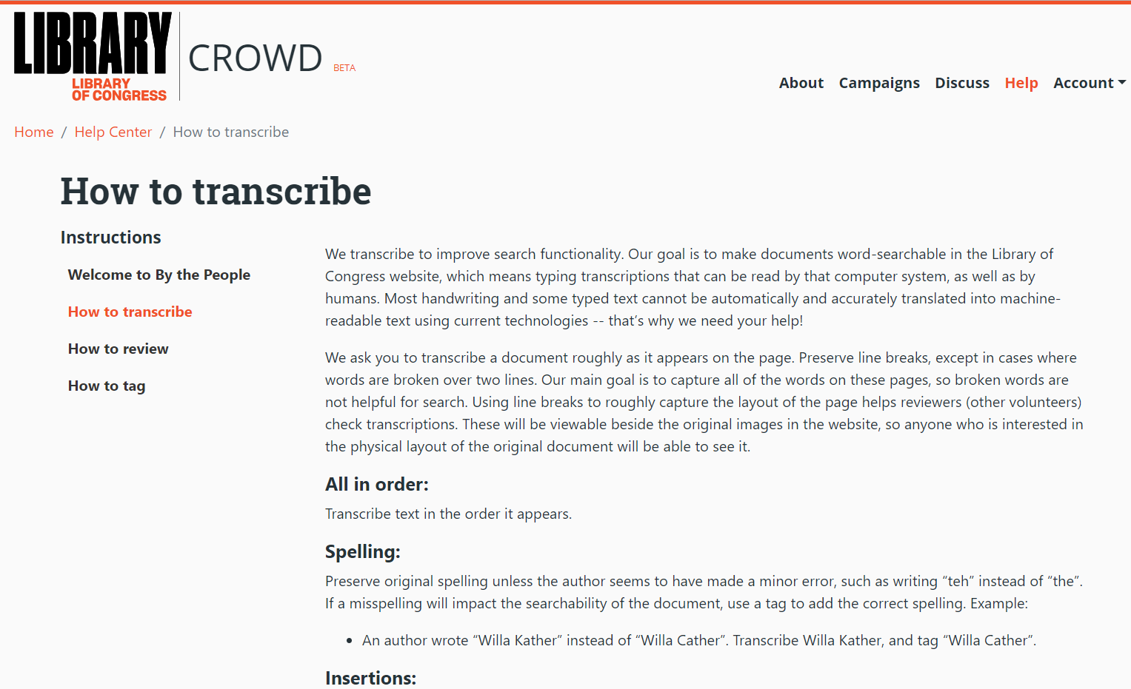
Notes:
Now we are quickly going to go over instructions for how to type transcriptions for By the People.
Search is our primary goal and that is particularly useful to keep in mind as you encounter questions about how and what on the page should be captured in a transcription.
You can view detailed instructions for transcription, review, and tagging at any time by clicking Help in the top right of any page. The site tries to give clear guidance for the most common issues you’ll encounter in the text. However, we can’t cover everything. For further guidance, you can also search the discussion forum, History Hub (available from any page as “Discuss”), where Community Managers weigh in on additional user questions. However, there will always be gray areas where you will have to navigate using your best judgement. That’s ok! You’re in a safe space to ask questions and work together to find solutions. The review process also means that you aren’t making choices in a vacuum. You may mess up occasionally, but your fellow volunteers are there to make corrections as needed.

Slide 14
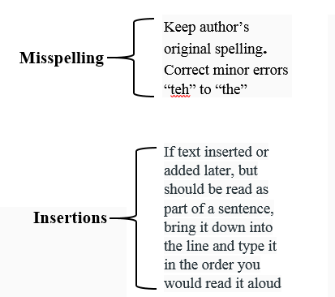

Transcription style guide
For misspellings of names or other significant “keywords” – use tags to add the correct term to the item.

Slide 15
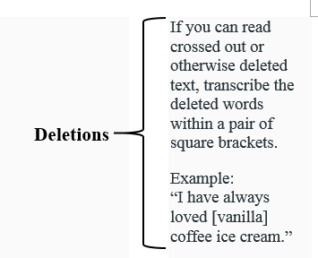
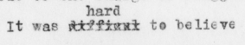
Transcription style guide

Slide 16
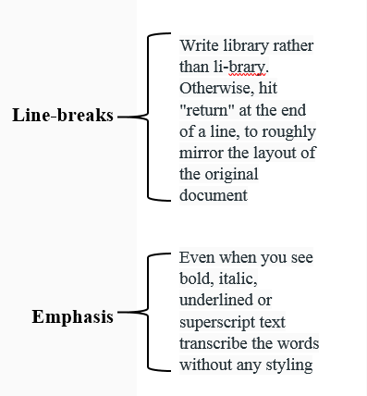
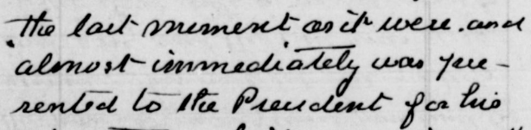
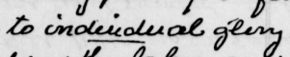
Transcription style guide

Slide 17
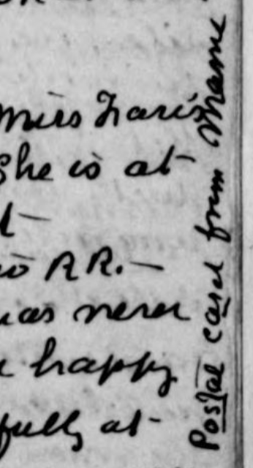
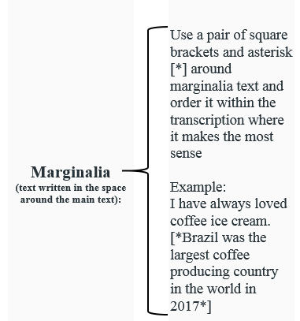
Transcription style guide

Slide 18
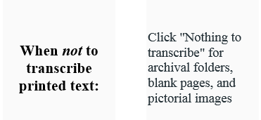
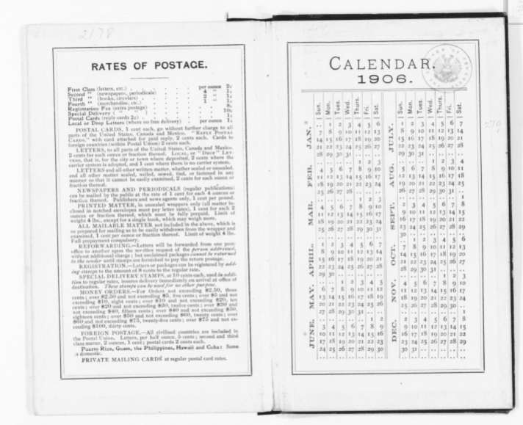
Transcription style guide
Click “Nothing to transcribe” for blank pages and template printed pages

Slide 19
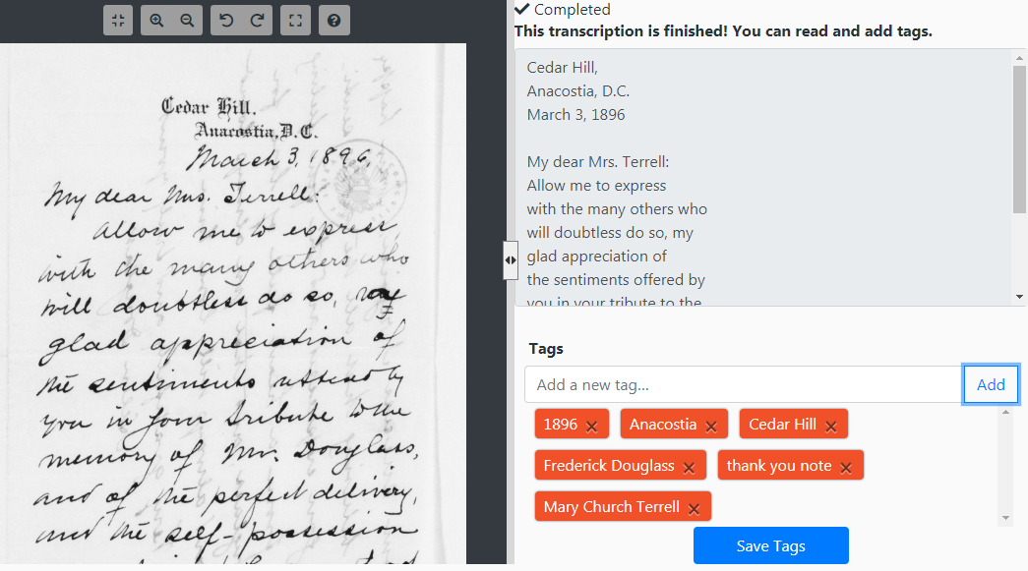
What about tags?
Notes:
Tagging is an experimental feature. Currently, By the People team does not have a way to return tags to loc.gov for search – though it hopes to eventually. So think of tagging as a tool to help other volunteers understand and navigate pages within the site.
Tag for search – what terms would you search for as a By the People user? It can also be used to add additional context, such as full names, correct spellings of terms misspelled in the original document, or information about the document such as the language it’s in or unique features like photos or illustrations

Slide 20
Let’s do this!
https://crowd.loc.gov
Notes:
Time to try it out!
Check out our Transcribe-a-thon instructions for ideas of large and small group activities to try out before having the participants strike out on their own.

Slide 21
Thank you for coming!
History Hub Discussion Forum:
historyhub.history.gov/
community/crowd-loc
Email:
Crowd@loc.gov
Twitter:
@Crowd_LOC
Newsletter: sign up at bottom of any By the People page
Stay connected and involved with By the People:

